Slide 1

What’s my House Worth?
SAURABH ANNADATE

Slide 2

Motivation for App
House pricing decisions are often subjective and can lead to bad investment decisions
Real estate agencies require accurate estimation of the price of a property to decide whether it is undervalued or not
Individual house buyers would like an objective estimate the worth of a house before making an investment decision
Mission is to build an app which would help accurately predict the price of a property based on certain characteristics like property type, no. of floors, age etc. which can be deployed as a website as well as an Android/iOS app

Slide 3
App Demo

Slide 4
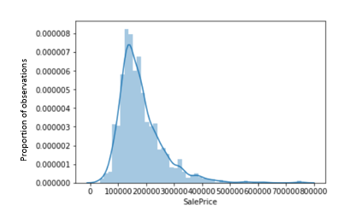
Data Analysis
Input Data:
Popular Ames Housing Dataset used for analysis
Source: Kaggle
Details:
Details of 1,460 properties and their SalePrice
Attributes include 79 explanatory variables
Total Area
Garage Area
No. of Fireplaces
Quality scores
…

Slide 5
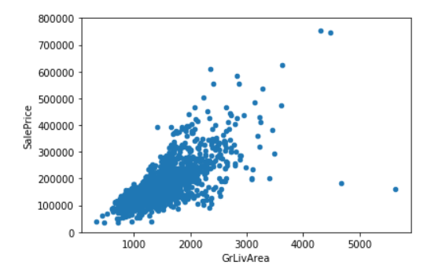
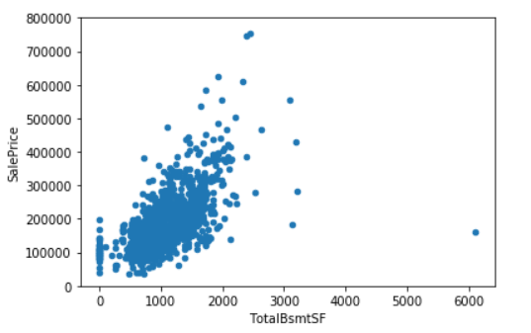
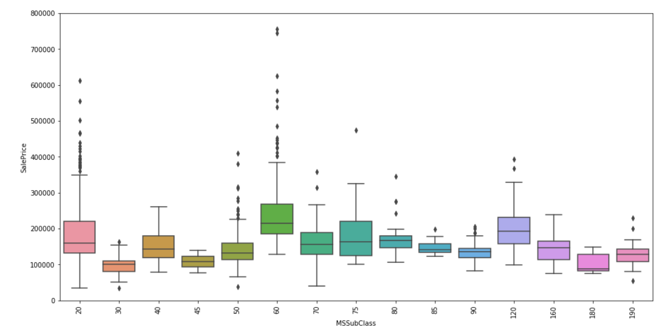
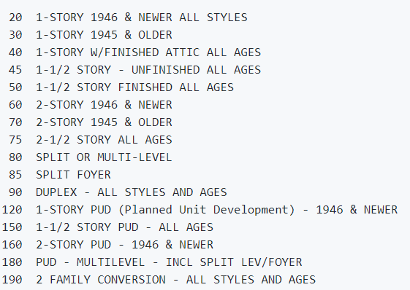
Interesting Insights
The price of a house seems to be strongly dependent on the total above ground square footage as well as the total basement square footage
Buildings built after 1946 generally tend to have higher prices than older buildings

Slide 6
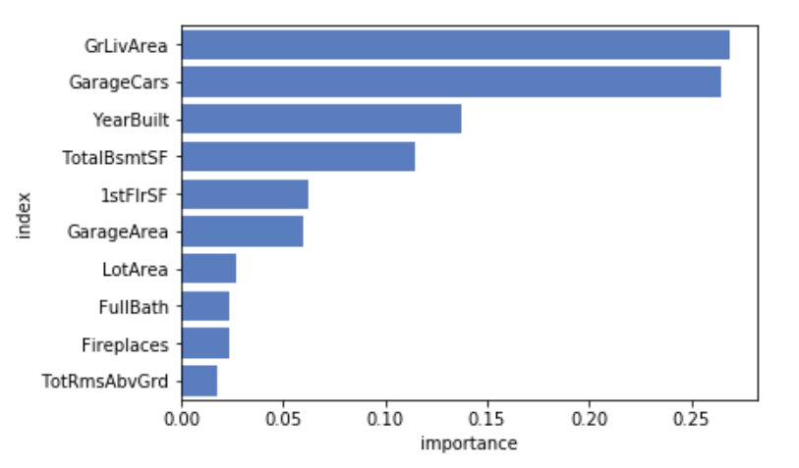
Modelling Results
Random Forest Regressor used for modelling
Quality scores excluded from modelling as these features are subjective or cannot be ascertained without consulting a professional
Final model contains 10 variables
Model Performance:
Model achieved an OOB R² of 82%
Success Criteria:
Model Criterion: Our model is successful if the R-square evaluation metric exceeds 60%
Desired Business Outcomes: A Key Performance Indicator of the success of the app would be continual increase in it's adoption to drive business decisions by the various Real Estate agencies and individual consumers. The intention is to deploy the app at a particular location, and based on the performance expand to other areas

Slide 7
References and Contact Info
For more information on this project, please refer:
Project Repo: https://github.com/saurabhannadate93/Whats-my-House-worth
Or contact:
Project Owner: Saurabh Annadate
Email: saurabhannadate2020@u.northwestern.edu

